Slide 1
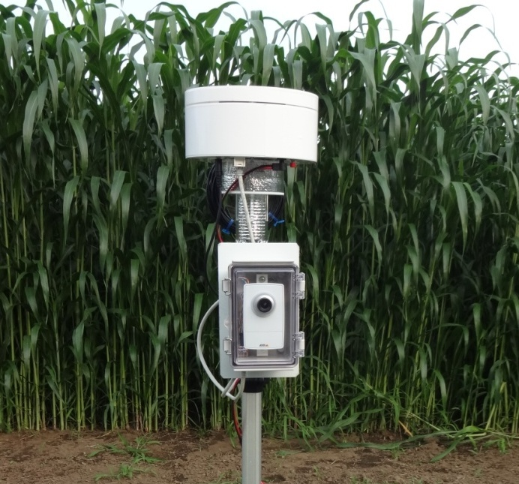
Field Server Setup Guide -- fs_classic22 --
Ver. 1.0 2014/9/24
Tokihiro FUKATSU @NARO
Notes:
This is a setup guide of “Field Server Classic.”
Field Server (FS) is Web-based monitoring system with
・ 3G/4G router or Wi-Fi module for connecting to the Internet
・ main computer unit connected various sensors with a Web server
・ network camera module to collect high-resolution image data
・ ventilation casing for outdoor use and accurate sensing
Users can monitor FS sensor data and image data via the Internet
when they access web pages of the FS with PC, tablet, and PDA.
In general, these data are automatically collected by remote control program
named “Agent System” at a remote site (ex. http://fsds.dc.affrc.go.jp/data4)

Slide 2
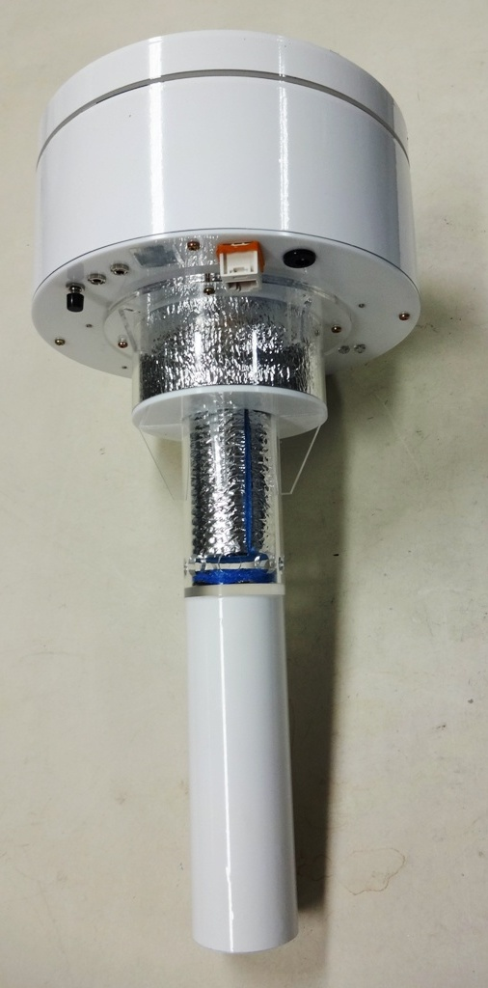
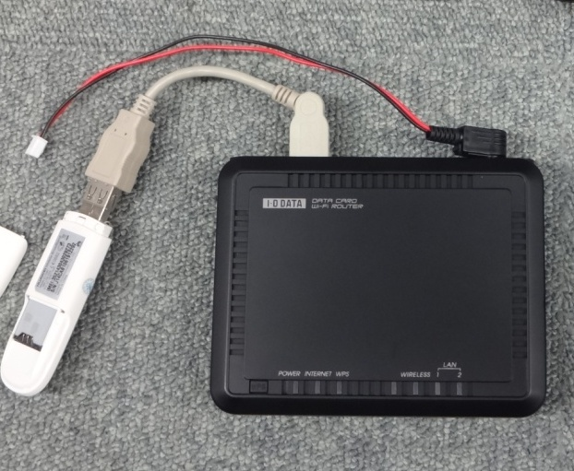
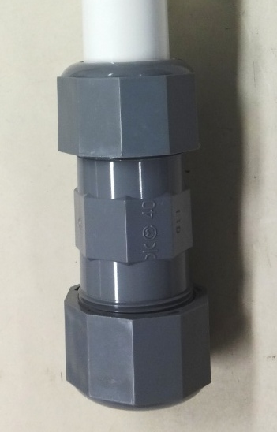
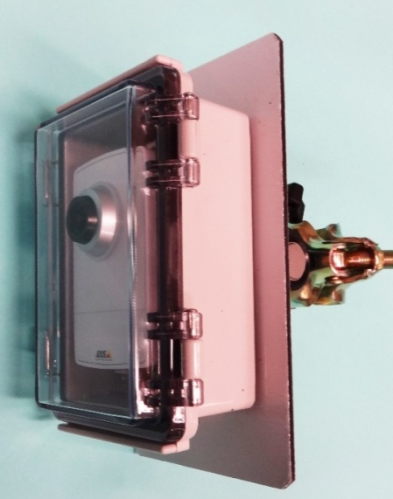
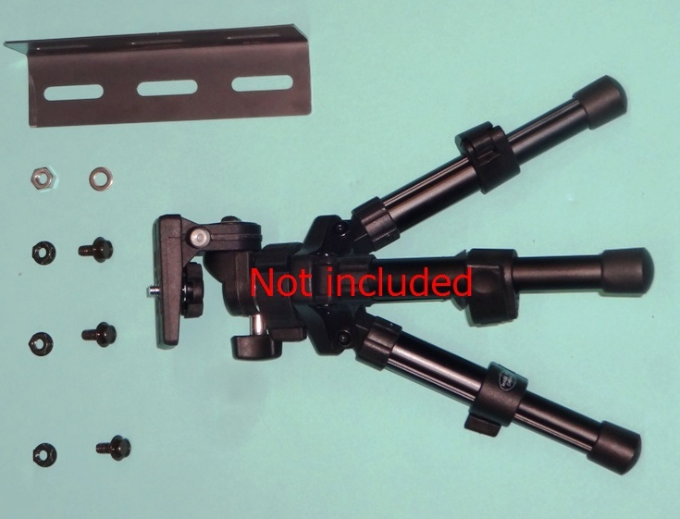
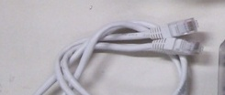
Contents
B
C
D
F
G
A
E
Notes:
This is a set of Field Server system except data collection system.
A: Field Server (standard version “Classic”) … 1
This is a main unit. A FS is generally deployed on a scaffolding pipe with (B).
B: Joint (expansion union nut I.D.:φ48.6mm) … 1
With this joint, we can easily connect FS and pipe by tightening up the joint screw.
C: Power supply adapter (In:100-240V, Out:12V) … 1
Use this adapter when you set up the FS or operate the FS.
In case of no commercial power source near the place of FS deployment,
please use solar panels and battery (not included)
D: 3G Wireless Router set (DCR-G54/U) … 1
This FS has a Wi-Fi Ethernet convertor, so we need a Wi-Fi hotspot near FS.
In no Wi-Fi hotspot area, you can use the FS by changing the communication
module embedded in the FS to this 3G wireless router (3G-sim card not included).
E: LAN cable … 1
connect the PoE port of the FS and the camera module with LAN cable (max. 20m)
F: Camera module (standard version “M1014”) … 1
you can set this camera module anywhere on a pipe or on a tripod (with G).
G: Tripod adapter (L-shaped angle & screw set) … 1

Slide 3
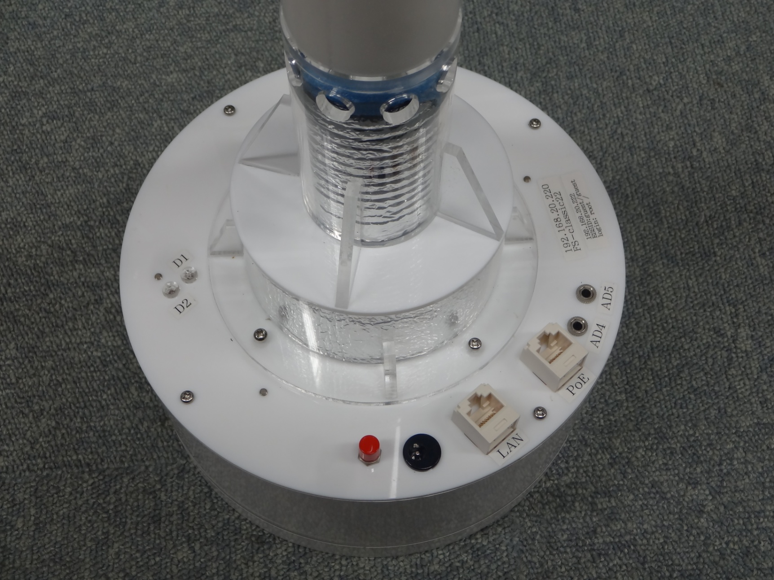
Part names and Functions
Main cover screw
indicator
sensor port
Mode selection switch
LAN port (12V PoE)
Power socket (In: 12V)
LAN port
Notes:
Indicator D1: turn on when the main power is on, and
turn off after the FS linked to the Internet successfully
Indicator D2: turn on when main power is on holding the red switch, and
the FS is booted in test mode (always-on operation)
LAN port (12V PoE): 1,2,3,6 pin --> LAN, 4,5 pin --> 12V, 7,8 pin --> GND
12V output is controlled on the FS Web page
connect this port to a FS camera module
Sensor port (AD4, AD5): you can plug option sensors with 3.5mm stereo plug
(pinout … Tip:5V, Ring:sensor output, Sleeve:GND)
A/D range: 0-1V or 0-5V (change source program of FS)

Slide 4
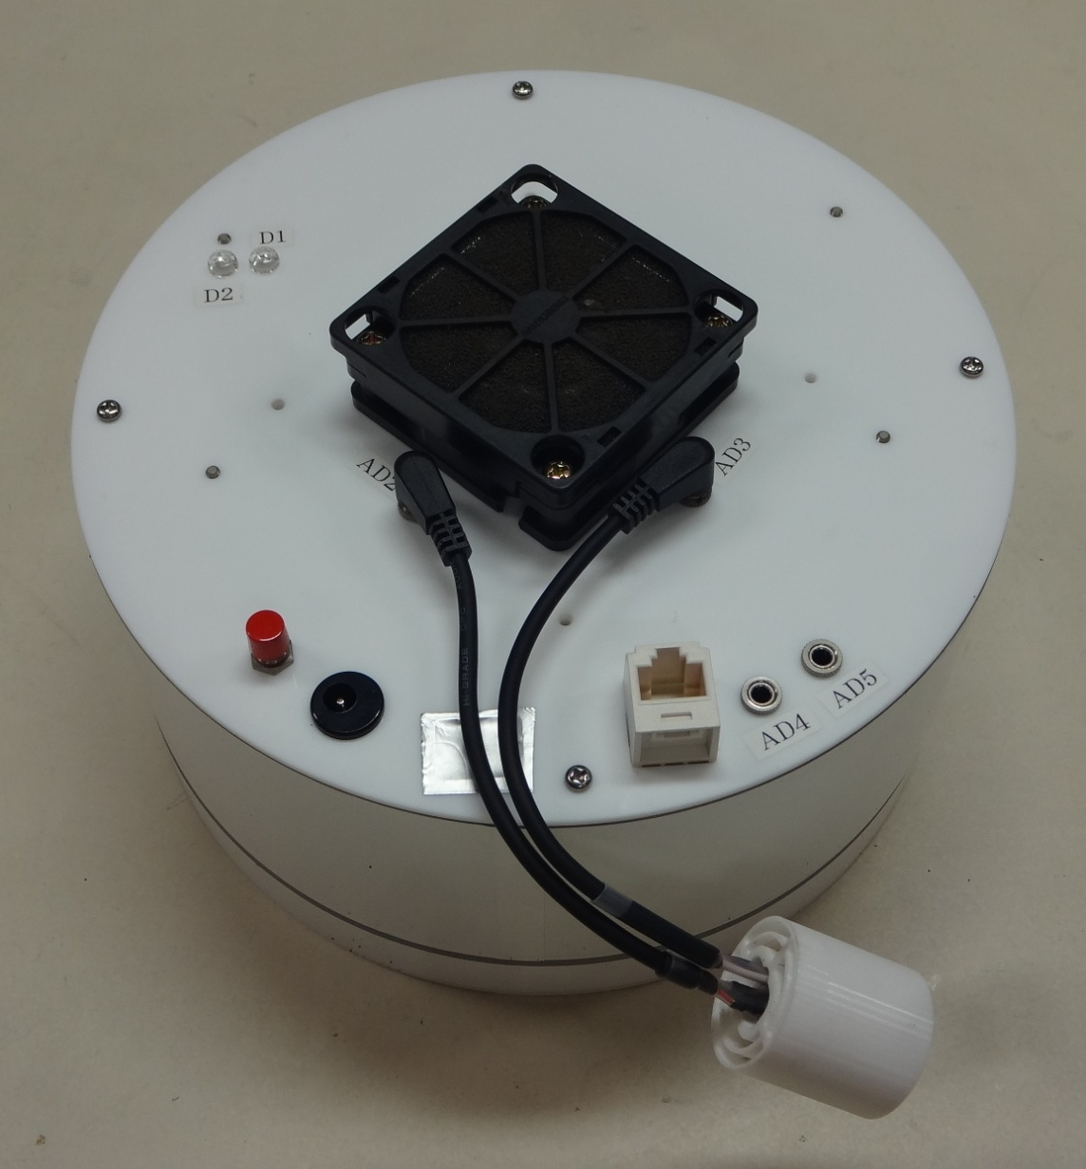
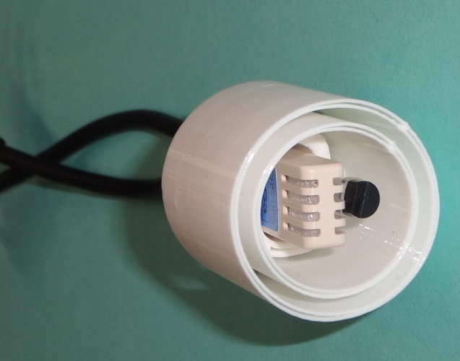
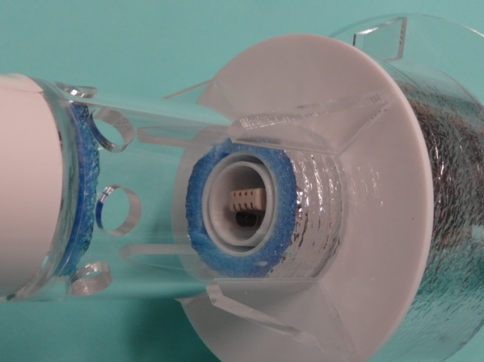
Part names and Functions
Sleeve
AD2 port
AD3 port
Air temperature & Humidity sensors
Slide down
Notes:
AD2: Air temperature sensor (LM35DZ with 200Ω/2kΩ resistors)
AD3: Humidity sensor (TDK CHS-UPS)
The sleeve of the sensor unit keeps the sensors in the center of air inflow.

Slide 5
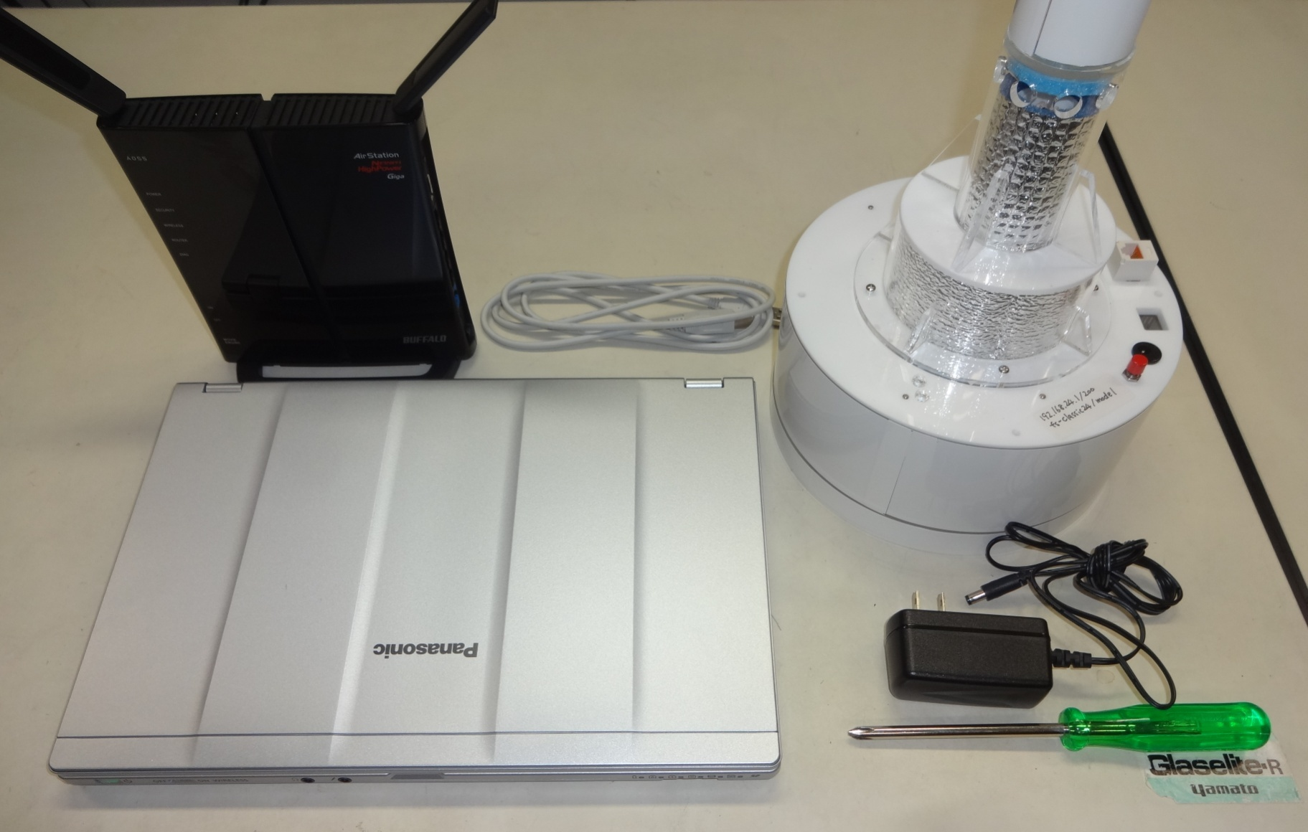
Preparation
USB cable (A-B type)
Wi-Fi router
PC
Phillips screwdriver
Notes:
Check Wi-Fi router setting and decide FS IP address.
We need this information,
・ ESSID & password (for connecting the FS to the Wi-Fi hotspot)
・ Default gateway, subnet mask, DNS server, and free IP address
・ FS IP address (for main CPU board, Ethernet converter, network camera)
In this document, we assume as below
・ gateway: 192.168.0.1 mask: 255.255.255.0 DNS: 192.168.0.1
・ ESSID: FieldServer / password: naroJP
・ initial FS IP address: 192.168.20.220(main), 222(LAN), 221(camera)
--> final FS IP address: 192.168.0.200(main), 202(LAN), 201(camera)

Slide 6
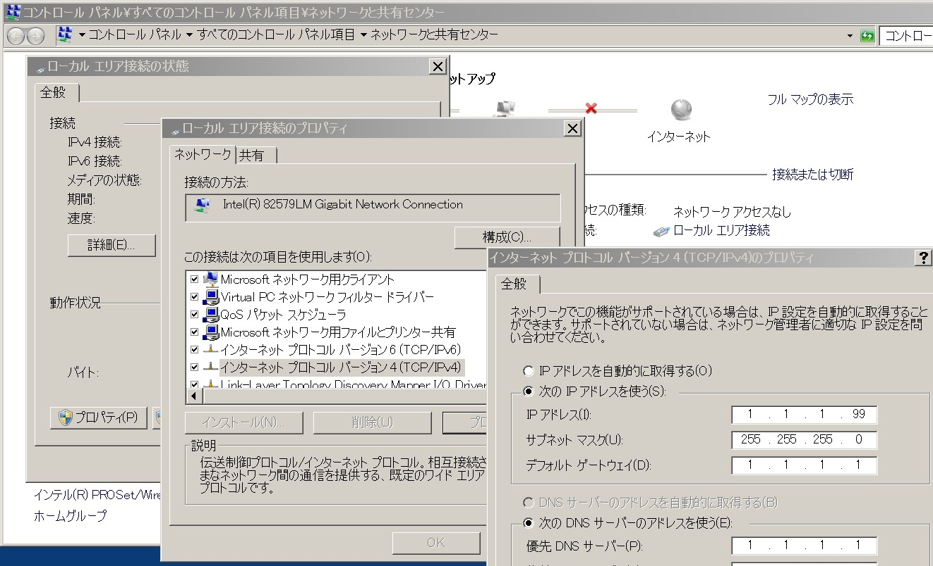
Setup (PC IP address)
①
②
④
③
Notes:
Change PC IP address so that we can access the FS on the PC.
Open “Network and Sharing Center” in “Control Panel” of Windows,
and click “Local Area Connection”.
Click “Properties”
Select “Internet Protocol Version 4 (TCP/IPv4)” and click “Properties”
Select “Use the following IP address” and input the following.
IP address: 192.168.20.** <-- any number from 2 to 254 except FS IP addresses.
(in this case, we can’t choose 220,221,221)
Subnet mask: 255.255.255.0
Default gateway: 192.168.20.1
Preferred DNS server: 192.168.20.1 (any IP address is OK)

Slide 7
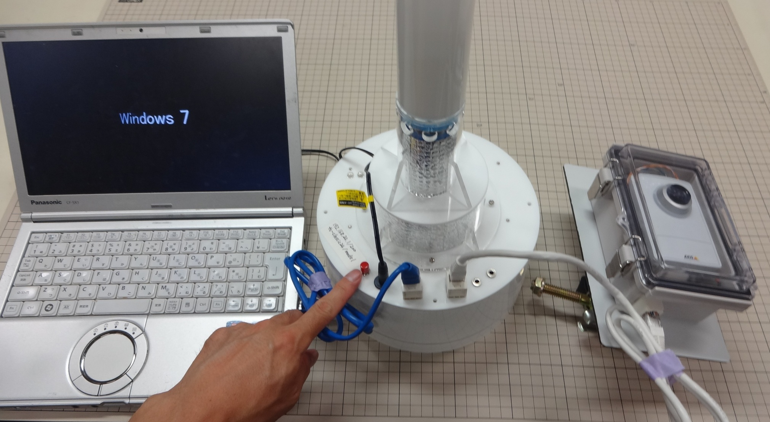
Setup (run FS for operating check)
②
③
④
①
Notes:
To check FS operation, connect cables and run FS on test mode.
Connect PoE port of FS and camera module with a LAN cable.
Connect PC and FS with a LAN cable.
(Be careful not to connect PC LAN port and FS PoE port.)
Hold the red button for booting the FS as a test mode.
Plug power supply adapter in the power socket of the FS.
Check LED indicators (D1 and D2 turn on)
Wait one or two minutes until the FS is booted on a test mode.

Slide 8
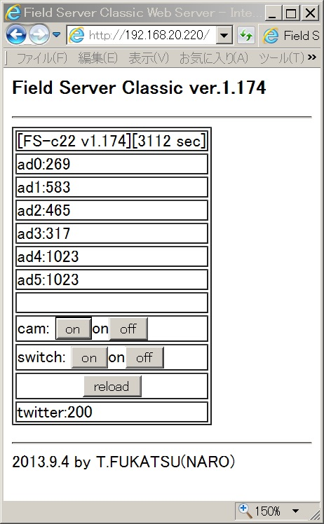
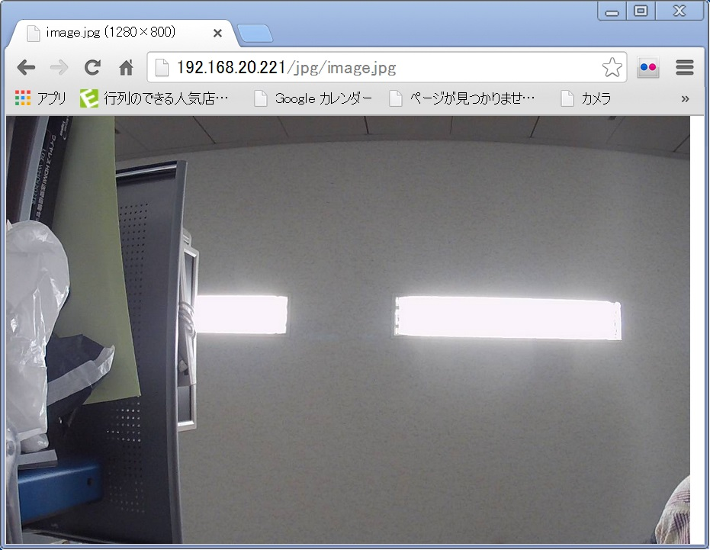
Setup (check each FS module)
Notes:
Open “command prompt” and check FS IP address with ping command.
(ex. ping 192.168.20.220 and check response)
Access FS web page with a web browser (ex. http://192.168.20.220)
Push cam “on” button to provide power to camera module if cam status is off
After waiting one minute, access camera web page (ex. http://192.168.20.221)
(This Axis M1014 camera doesn’t work well on IE, please use Google chrome)
5. Access the IP address of Wi-Fi modules for checking (ex. http://192.168.20.222)

Slide 9
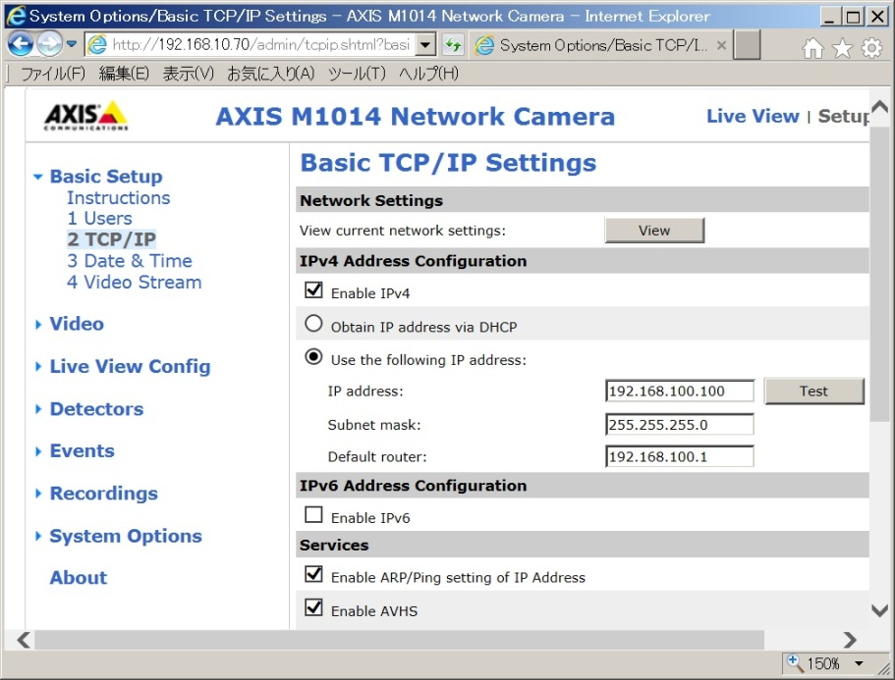
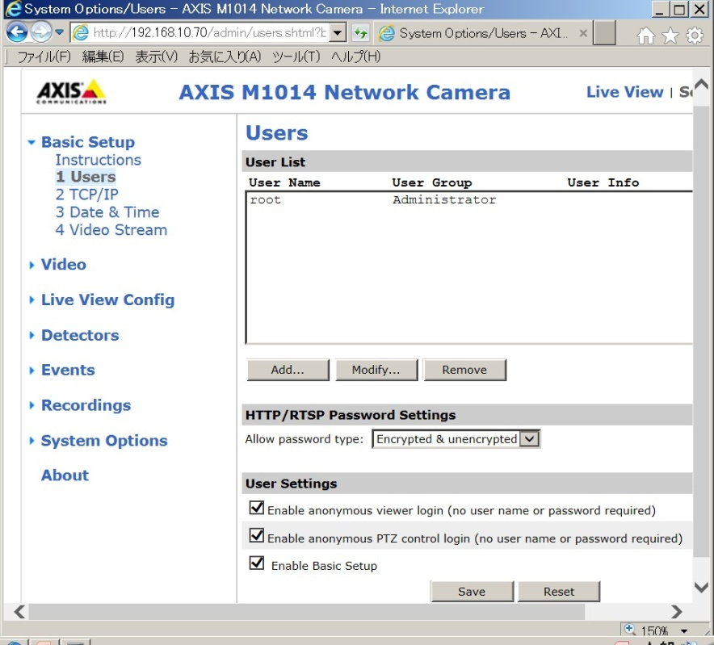
Setup (change camera IP address)
Set your IP address
Select these items
Notes:
Access the camera module IP address (ex. http://192.168.20.221)
Click “Setup” in the upper right of the web page and input password.
(ex. Username :root(fixed) /Password: password)
Select “Users” in “Basic Setup”, and select all checkboxes in “User Settings”
Select “TCP/IP” in the “Basic Setup”, and input your IP address.
(ex. 192.168.0.201 / 255.255.255.0 / 192.168.0.1 )
5. Reboot the camera. (unplug PoE LAN cable and re-plug it)

Slide 10
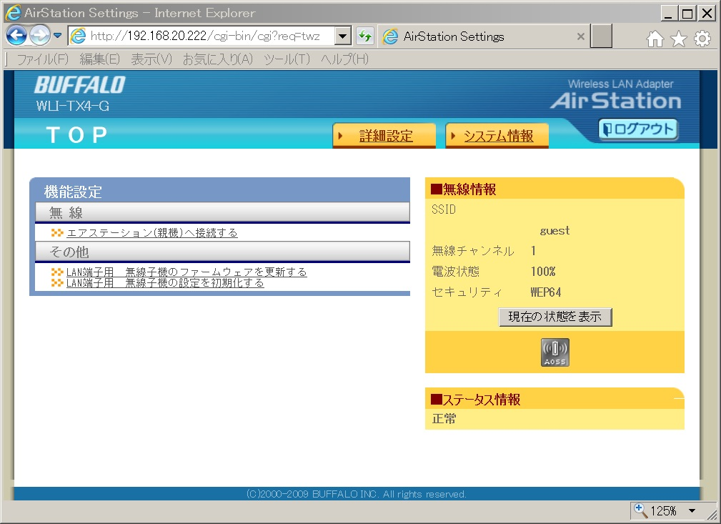
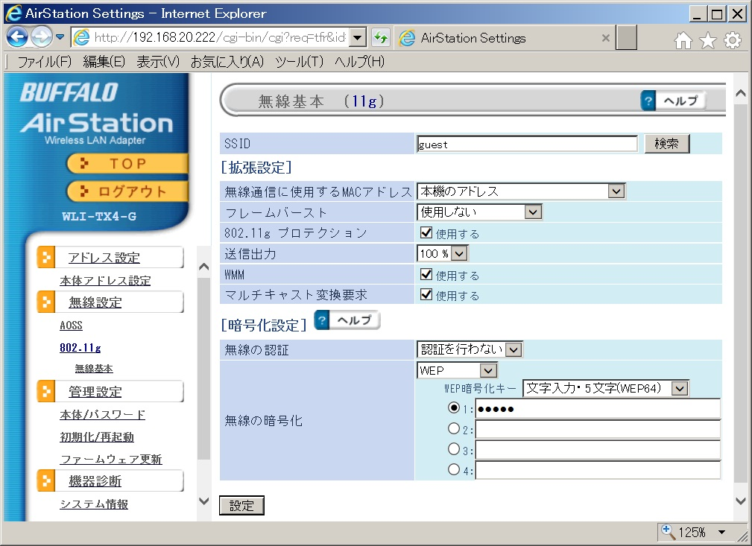
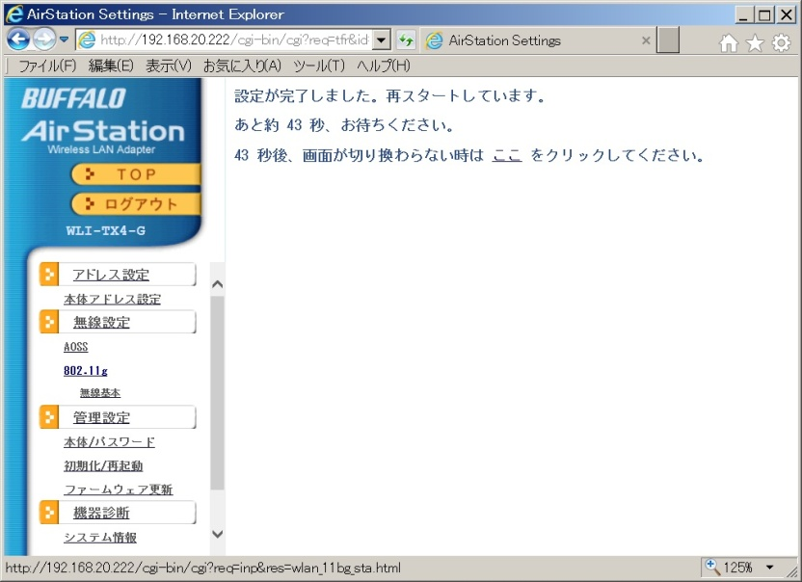
Setup (change Wi-Fi module setting)
②
③
①
④
⑤
Notes:
Access the web page of the Ethernet converter (default Wi-Fi module).
(ex. http://192.168.20.222 [root/none])
You need to reload the web page a few times so that it can be displayed (bug?).
Click the left orange tab (①) and move to the setting web page.
Select 802.11g (②) and set Wi-Fi connection parameters.
Click the upper-right tab (③) and the ESSID list around the Wi-Fi module is automatically displayed
Choose target ESSID from the list and input security parameters (④)
After clicking the below tab (⑤), the Wi-Fi module will be restart within 43 seconds.

Slide 11
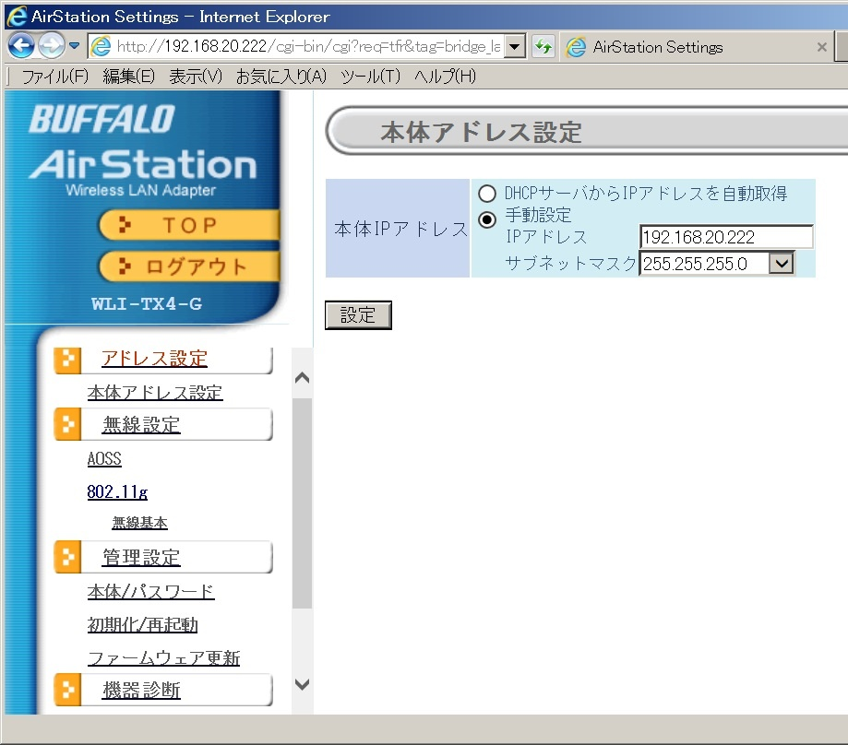
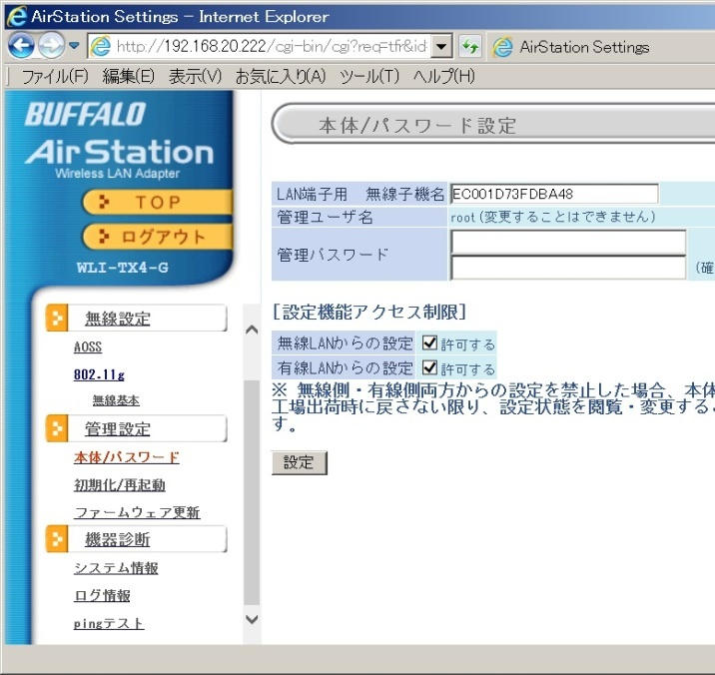
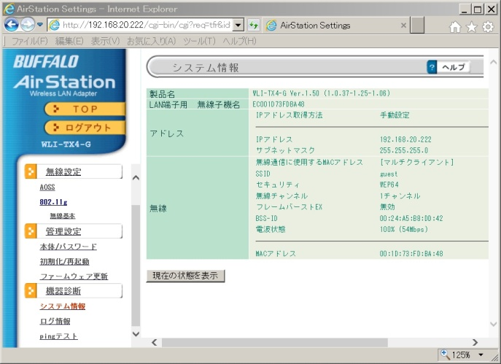
Setup (change Wi-Fi module setting)
①
⑤
④
⑥
②
③
⑦
Notes:
Click the top of left select tabs (①) to set IP address of the Ethernet converter.
Change IP address (ex. 192.168.0.102) and subnet mask (ex. 255.255.255.0) (②) and push the set button (③)
Select the ④ tab and you can set (change) the root password by ⑤ and ⑥ (you can’t change user name)
Select the ⑦ tab and you can see the setting information of the Ethernet converter.

Slide 12
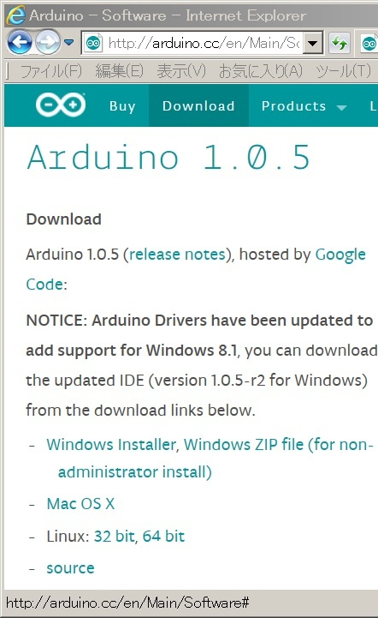
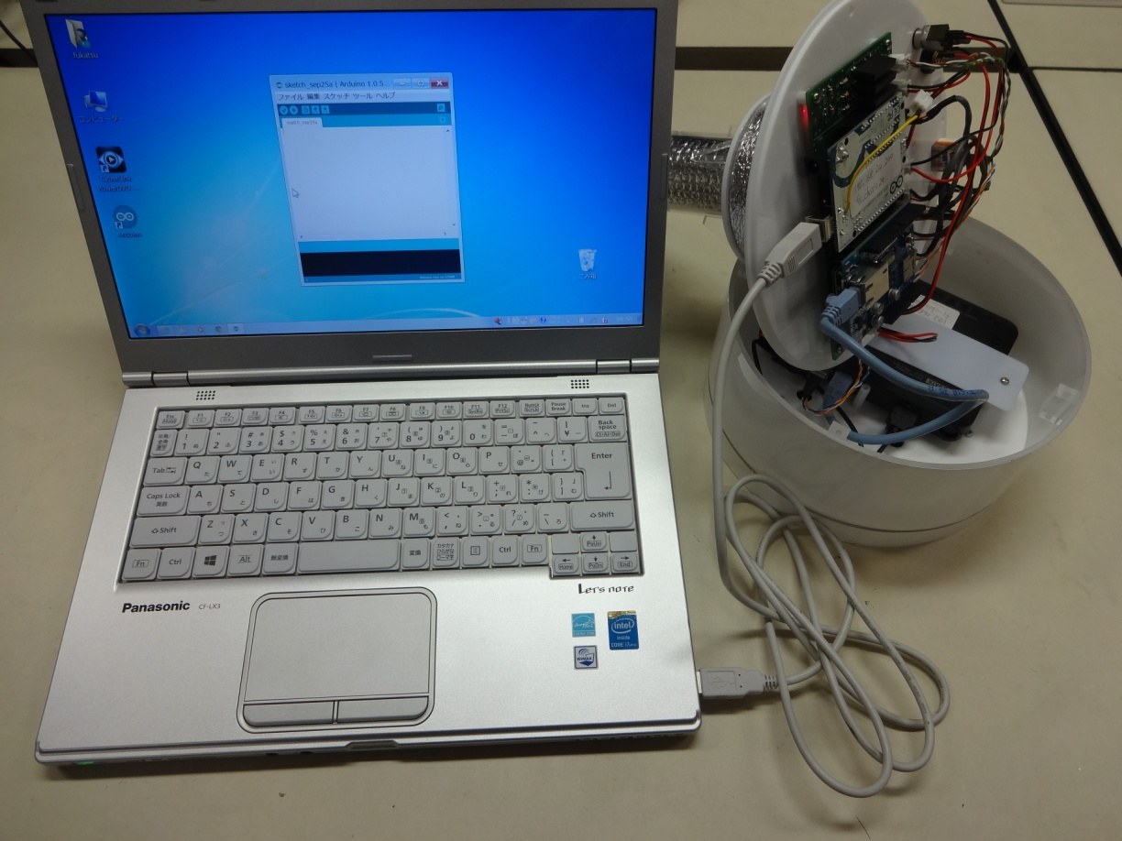
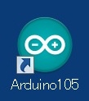
Setup (preparation of using Arduino)
Notes:
Arduino UNO is used in a FS main board with an original FS shield (a support circuit)
Install Arduino IDE software to your PC. (ex. http://arduino.cc/en/Main/Software )
Unscrew the four main cover screw and open the FS
Connect PC and Arduino UNO on the main board with a USB cable (A-B type)
The USB power is provided to the main board (and FAN) via the Arduino UNO (!)
4. Open Arduino software and select a proper serial port of the Arduino UNO

Slide 13
Setup (Arduino program parameter)
①
②
③
④
Notes:
You can download the main FS program for Arduino at
http://fsds.dc.affrc.go.jp/data1/OpenFS/Arduino/
Open “fs_classic**_ver1173” and adapt some parameters to your situation.
Title name: This string is displayed on FS web page and FS twitter for identification.
FS return from power-saving mode to monitoring mode every hour “wake_up_Time” seconds
after the hour, and keep the monitoring mode for “wake_Period” seconds.
(ex. In this case, working at **:55～**:04 (60x10seconds), and sleeping at **:05～**:54)
Set your IP address and mac address the number of which you can check
on the back side of the “Ethernet shield” embedded on the main board.
(Caution: if default gateway is not *.*.*.1, you must set “dns_ip”, “gateway”, and “subnet”)
Write twitter token for twitting FS data every hour.
See the web page to get twitter token. http://arduino-tweet.appspot.com/
if you want not to twitte FS date, set “twitter_flag” is “false”

Slide 14
FS main program flowchart(setup)
12V in
NTP access
Push red button
NTP failed
NTP success
D1: on
D1: on
D1: on
D1: off
D2: on
D2: off
Tweet
FAN start
Test mode
Sleep
Wait for wireless
Main loop
Notes:
This is FS main program flowchart.
・ After plug 12V main power, LED D1 turns on.
・ If main power is on holding the red switch, LED D2 turns on and FS is booted in test mode.
・ After running FAN, wait a minute (“wireless_wait”/1000 seconds) for network.
・ Access NTP server. If FS has the time successfully, the LED D1 turns off.
・ Tweet the time (min*60+sec) and sleeping time if network is ok and “twitter_flag” is true.
・ Turn off FAN and wireless, and sleep until time becomes “wake_up_time” after the hour
(if FS is test mode, skip this sleep and executes main loop)

Slide 15
FS main program flowchart(main_loop)
Main loop
Camera on
FAN start
Web server on
Test mode
Wait for wireless
Check time
Test mode
monitor
Sleep
Tweet
Main loop
Notes:
In main loop (“wake_Period” seconds from “wake-up_Time” after every hour)
・ running FAN and wait a minute for network (in normal mode)
・ monitor A/D sensor data (average 8times) ,tweet data, and turn camera power on.
・ start web server and you can see the data on the web (ex. http://192.168.20.220)
・ After “wake_Period” seconds, turn camera/FAN/wireless power off
and wait “wake-up_Time” after next hour.
In normal mode, FS main program automatically reboot every day
after main loop at DEFAULT_RESET_HOUR ()
(ex. 5:55: Main loop start, 6:05: Main loop stop, 6:05: reboot)
If you want to operate FS continuously, hold the red button or
Set “wake_Period” 60*57(sec) for semi continuous mode

Slide 16
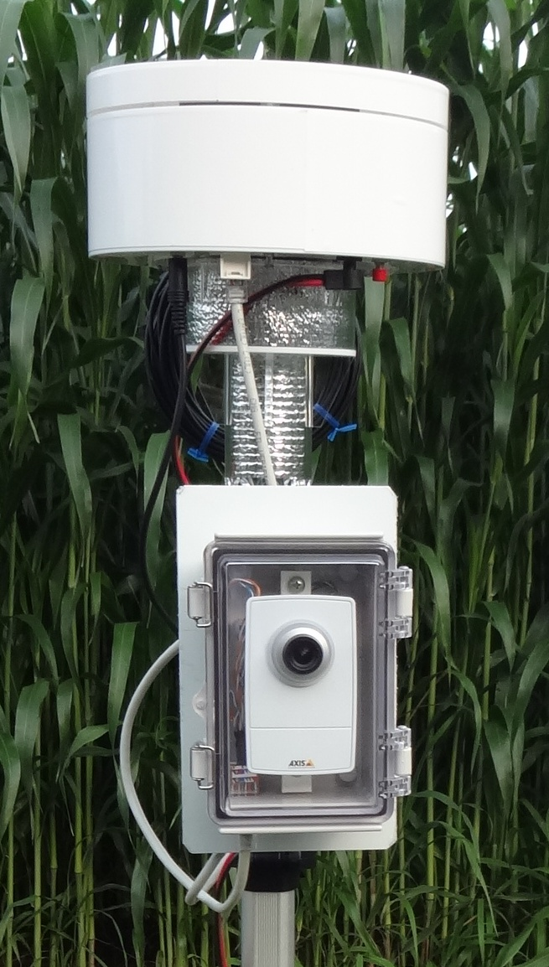
Operate FS in test mode
・ Connect camera and FS PoE port
・ Check Wi-Fi hotspot is available
・ Plug the power holding red button
・ check D1/D2 on and then D1 off
・ access FS/camera web pages
・ check twitter data (twilog data)
・ reboot FS as a normal mode

Slide 17
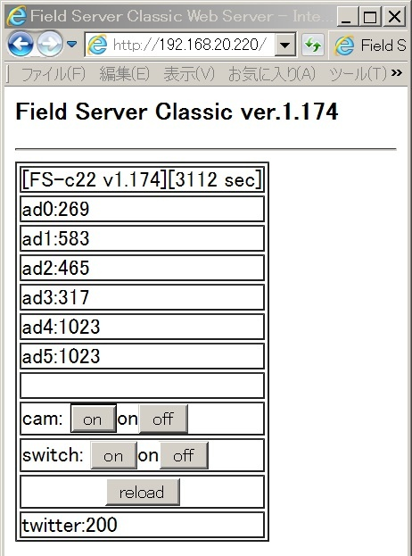
FS Main web page
Elapsed time
Sensor RAW data (0-1023)
CPU temp. = ad0/1024*100 (C)
battery = ad1/1024*16 (V)
Air temp. = ad2*0.108-8.2(C)
Humid. = ad3*0.086+14(%RH)
Raw data = ad4・ad5/1024(V)
Control camera power
Control FAN power
If success tweet, indicate 200

Slide 18
Calibration data

Slide 19
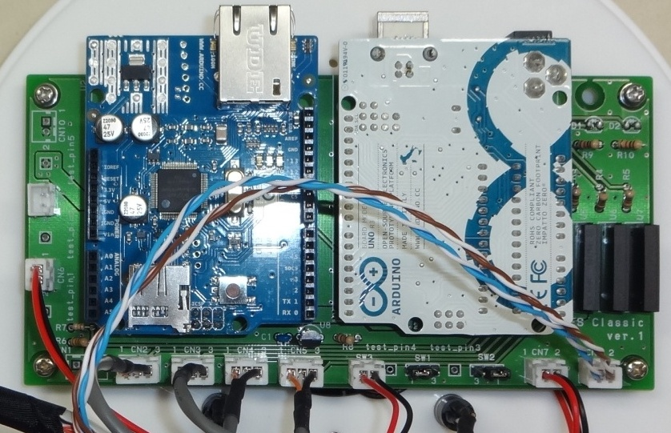
FS main board
5V out
12V out
Main 12V in
Mode switch
FAN power
ad2
ad3
ad4
ad5
PoE power

Slide 20
FS main board circuit schematic

Slide 21
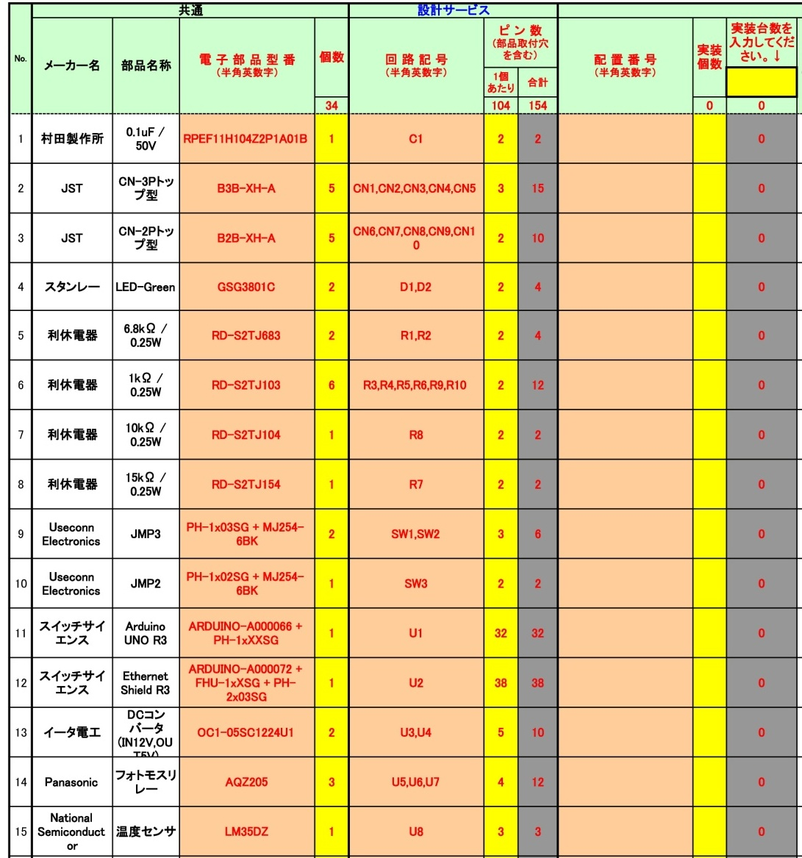
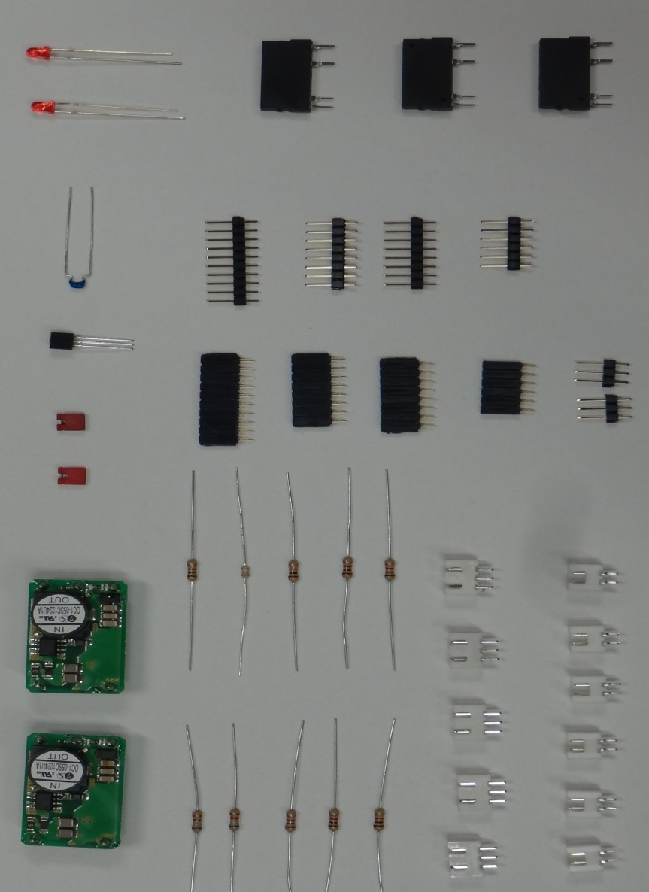
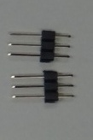
FS main board parts list
4
14
9
1
11
15
12
9
5,6,7,8
2
3
13
10

Slide 22
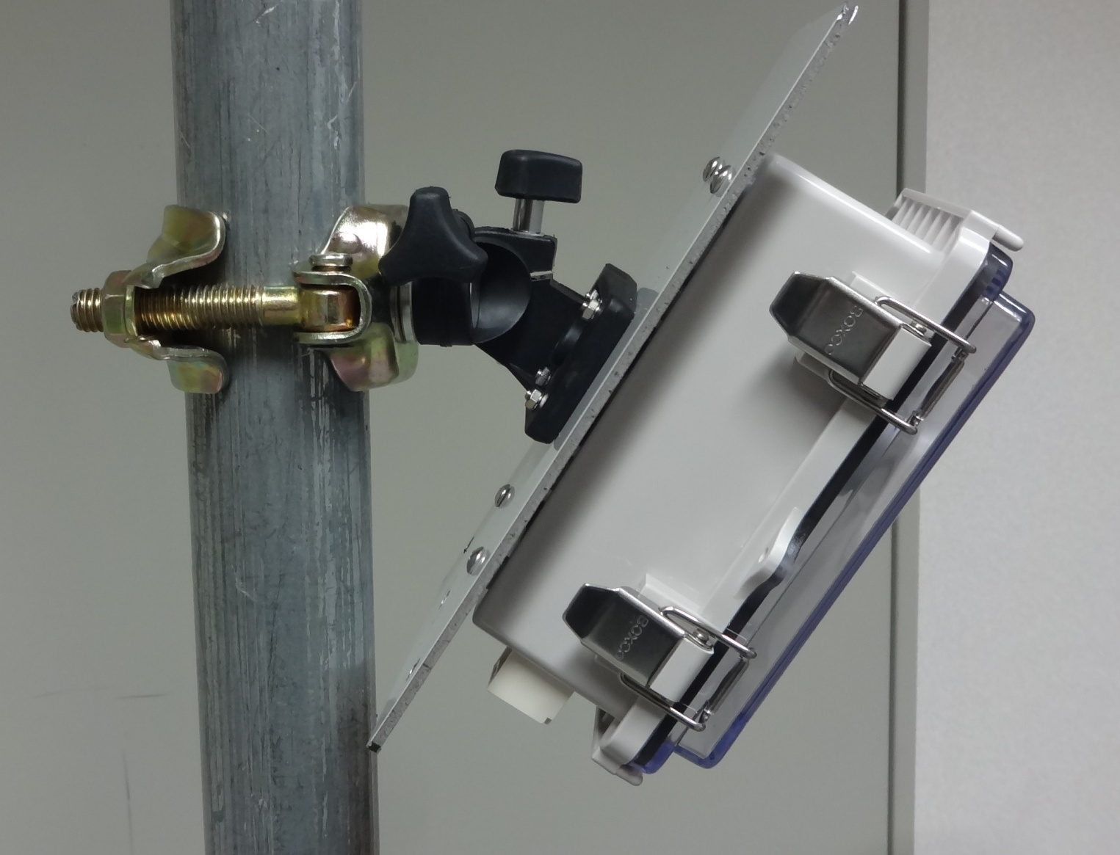
Camera module on pipe

Slide 23
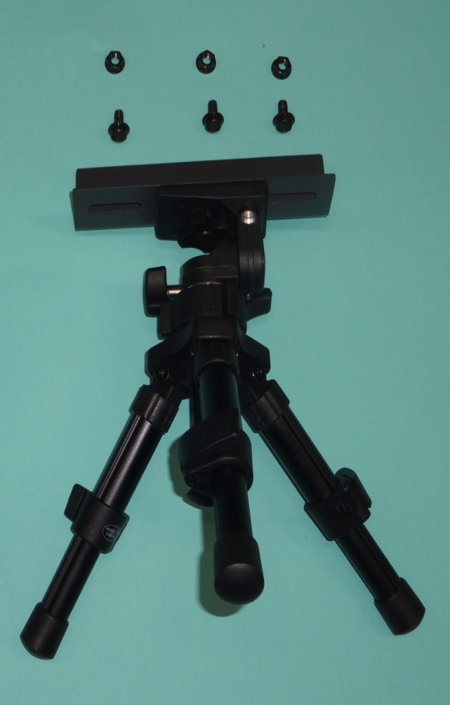
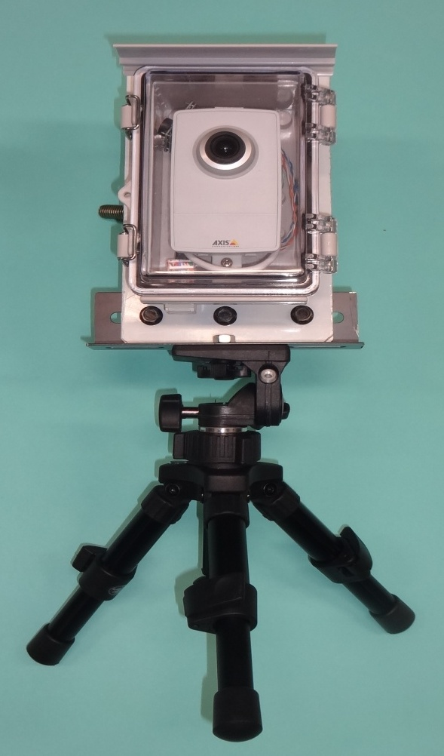
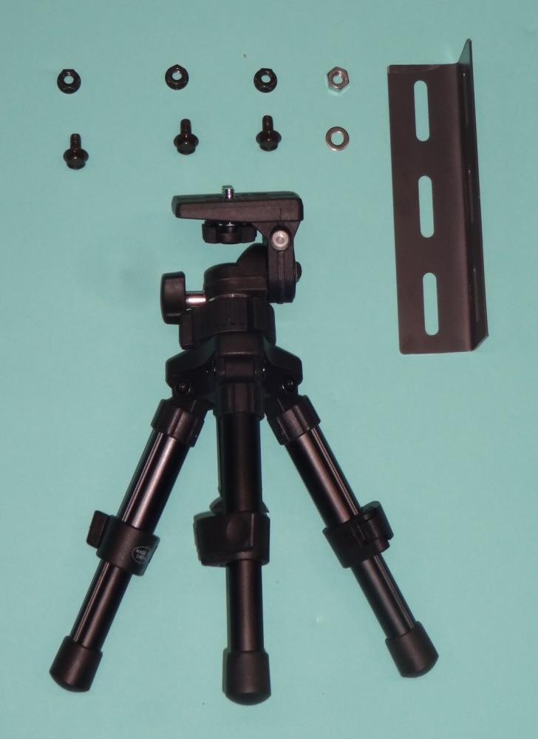
Camera module with tripod
tripod

Slide 24
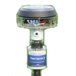
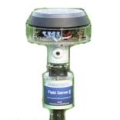
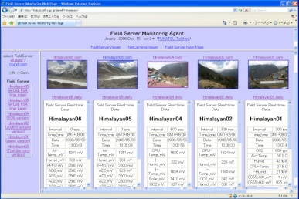
Collect data by “Agent System”
User
Field Server
Internet
Agent
System
XML
Parameter file
Web application
Web page
Database
Agent system automatically collect & display data
Notes:
If we can access FS via the Internet, our FS control program “Agent System”
can collect FS data and display it on our data server (http://fsds.dc.affrc.go.jp/data*)
If FS is operated on private IP, you need to set Port Forward or other setting.
If you use 3G/4G router by changing the FS communication module,
Please check whether your 3G-sim get global IP address or not.
(DCR-G54/U has DDNS function, so you can access FS as http://fs_classic22.iobb.net)

